Slide 1


Slide 2
Aim of the Project
Health Armband Monitor
Provide Health information during the day
Comfort of Use
Ease of Use
Provide more information than the usual Sport SmartWatches

Slide 3
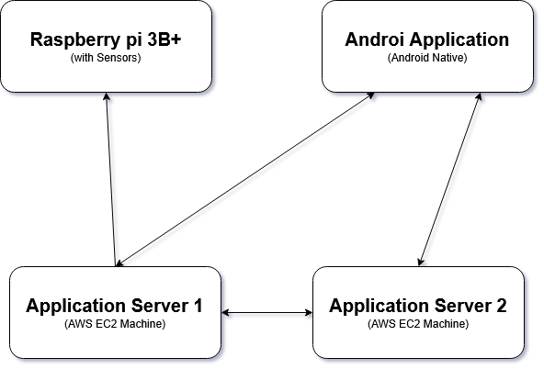
Project Flow

Slide 4
Testing & Problems
To test our device we used the full system (Application + Armband) a whole day.
Problems:
RAM
Cloud
Possible Solutions:
Upgrade of the data algorithms to make them use less RAM during the calculations
Use of a cloud system and implement a logic of secure connection between the cloud and the Raspberry Pi

Slide 5
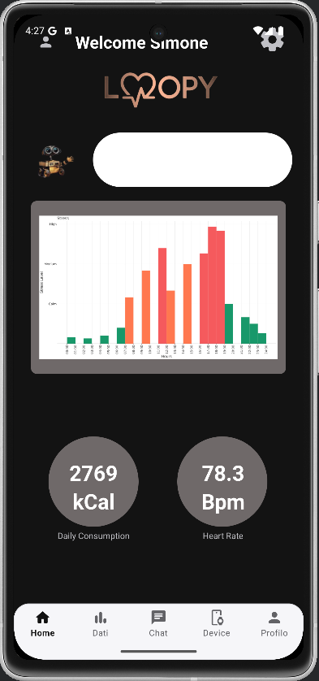
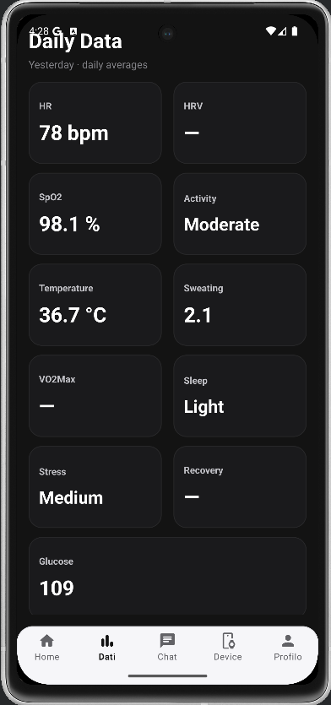
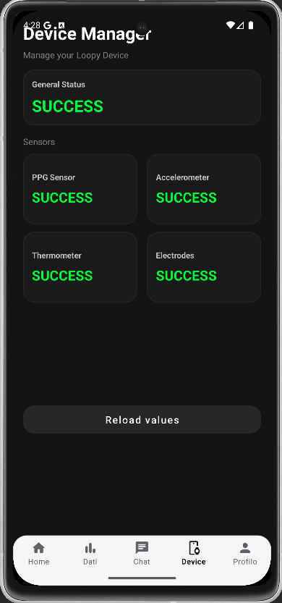
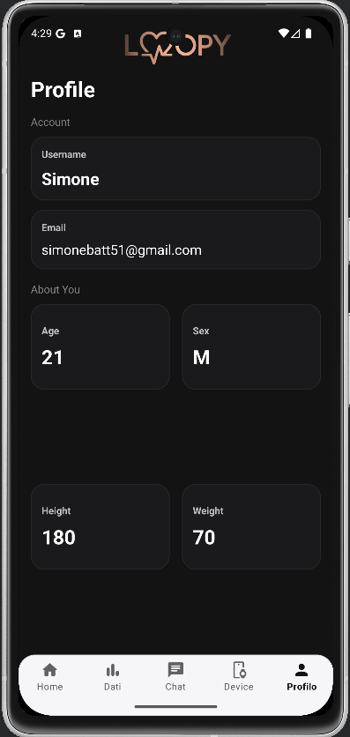
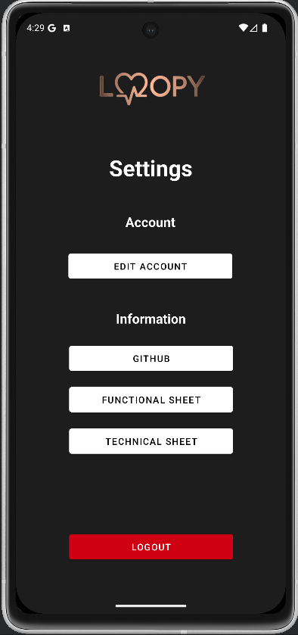
Remote Management
To manage the information retrieved from the device remotely we created a Mobile Android Application.
The application is composed by 6 screens in total: HomePage, Data, Chat, Device Status, Profile and Settings.

Slide 6
Future Ideas
Use of a smaller MicroController to make the device more easy and comfortable to wear
Improve the AWS Machines to use a single one
Make it wearable also in different part of the body, not only the arm
Improve of the Algorithms
Security and Encryption on Login and Register phases
Improvement of LLM usage with more specified LLMs or create an appropriate custom LLM.

Slide 7
Questions?
Functional Sheet
Technical Sheet

